Slide 1
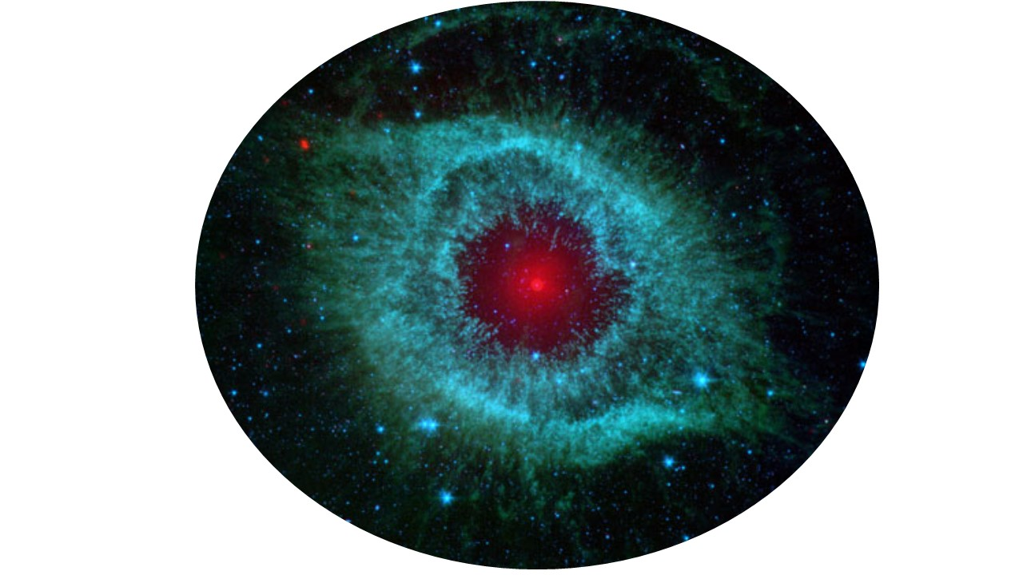
Helix Eye In The Sky
Machine Learning Enhancements to Home Security Camera System
Brandon Fick, Raleigh Love, Franko Ortmann, and Scott Stevener
2019 Data Analytics & Visualization Bootcamp Final Project

Slide 2
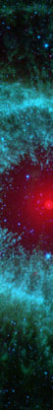
Challenge
Many of today’s home security cameras send users an alert when any movement is detected and recorded.
Movement can be caused by
Receiving too many false positive alerts can be overwhelming, and can lead users to ignore alerts, or deactivate this important feature altogether.
People
Vehicles
Wildlife
Weather (moving tree limbs/leaves, rain, snow, etc.)
Insects
Blowing trash
Changes in ambient lighting

Slide 3
Solution
Reduce the number of false positive alerts using a machine learning system to evaluate and identify specific content in a security camera image.
Send alerts only when the presence of a person or unrecognized automobile is captured by the camera.

Slide 4
Tools Used
Python Pandas
Python Flask
MongoDB Database
Keras Pre-Trained Models
ImageNet
Twilio
Dropbox
HTML/CSS/Bootstrap
SV3C IP POE HD Camera
Camera Software

Slide 5






Helix Eye In The Sky Workflow
Xception
Keras Trained Models
ETL
Saved Image
Camera
Car
Person
Other
Website
Secondary Model
Unknown Car
Person
Family Car
Empty Driveway
Send Alert
No Action

Slide 6
Secondary Model Workflow
Car Secondary Model (Comparative)
Person Secondary Model
Daytime - Empty driveway
Daytime – Known Truck arriving
Daytime – Known Truck turning in
Daytime – Known Truck turning out
Daytime – Known Truck leaving
Daytime – Known Car arriving
Daytime – Known Car turning in
Daytime – Known Car turning out
Daytime – Known Car leaving
Nighttime – Empty driveway
Nighttime – Known Truck arriving
Nighttime – Known Truck turning in
Nighttime – Known Truck turning out
Nighttime – Known Truck leaving
Nighttime – Known Car arriving
Nighttime – Known Car turning in
Nighttime – Known Car turning out
Nighttime – Known Car leaving
Day or Night?
Does image best match any scenario above a certain threshold?
Day
Night
Empty Driveway?
Empty Driveway?
Yes
No
Yes
No
Yes
No
Send Alert
Family Car
Unknown Car
Person
Empty Driveway
No Action

Slide 7
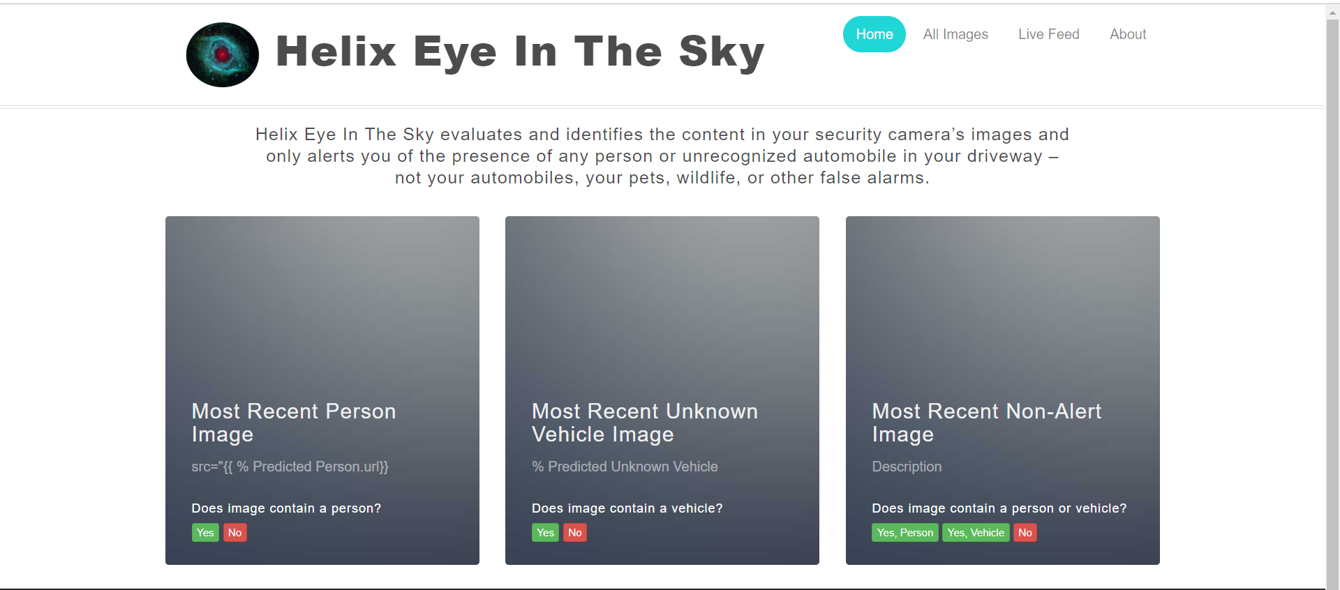
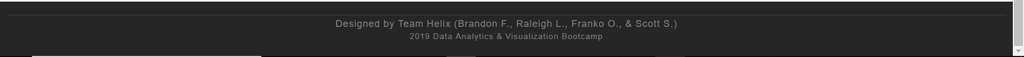
SPACEHOLDER IMAGE

